Slide 1
Text preprocessing

Slide 2
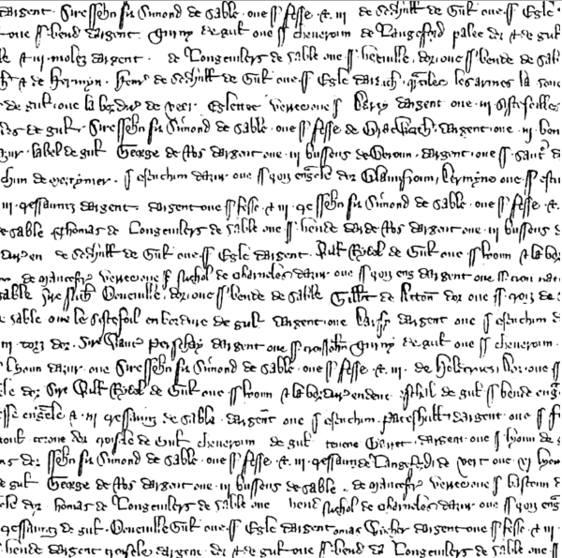
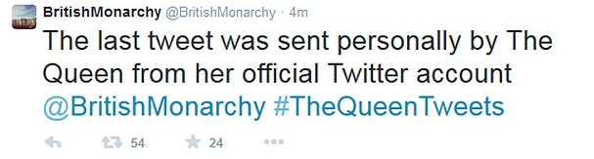
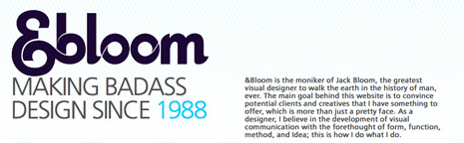
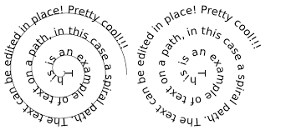
Plain (raw) text

Slide 3
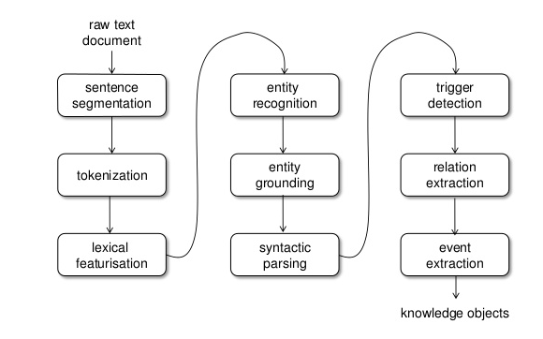
The way from plain text to the results

Slide 4
Regular Expressions

Slide 5

Regular expressions
A formal language for specifying text strings
How can we search for any of these?
chipmunk
Сhipmunk
chipmunks
chippmunk

Slide 6
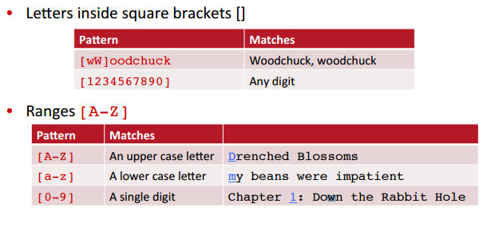
Disjunctions

Slide 7
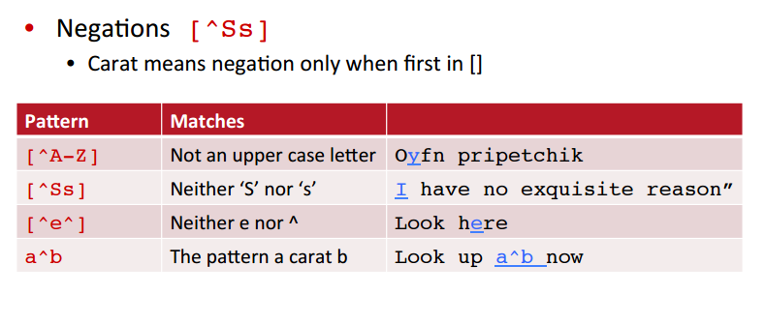
Negation in Disjunctions

Slide 8
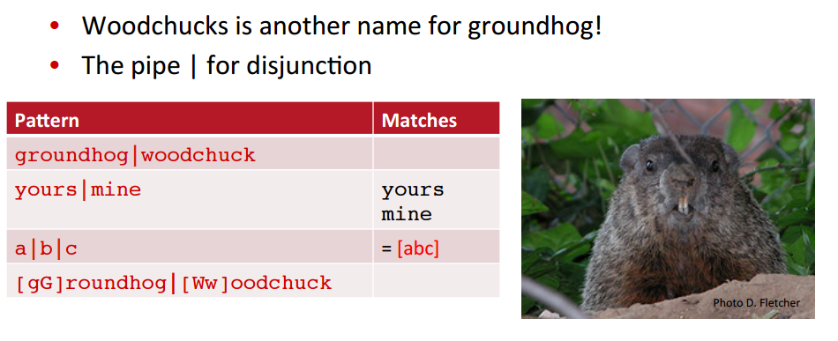
More Disjunction

Slide 9
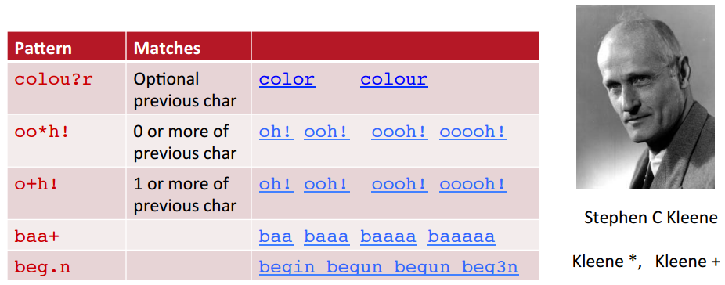
Regular Expressions: ? * + .

Slide 10
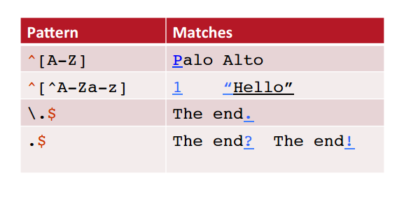
Regular Expressions: Anchors ^ $

Slide 11
Text cleaning

Slide 12

The process of text cleaning
Tokenization
Digits removing
Stopwords removing
Punctuation cleaning
Coding
Stemming

Slide 13
Punctuation removing
B
E
F
O
R
E
Neuro-linguistic programming (NLP) is an approach to communication, personal development^^^, and psychotherapy created byRichard Bandler and John Grinder% in California, United States in the 1970s***. Its creators claim a connection between the neurological processes (neuro-), language (linguistic) and behavioral patterns learned through experience (programming), and that these can be changed to achieve specific goals in life.^{[1][2]}
Neurolinguistic programming NLP is an approach to communication personal development and psychotherapy created by Richard Bandler and John Grinder in California United States in the 1970s Its creators claim a connection between the neurological processes neuro language linguistic and behavioral patterns learned through experience programming and that these can be changed to achieve specific goals in life12
A
F
T
E
R

Slide 14
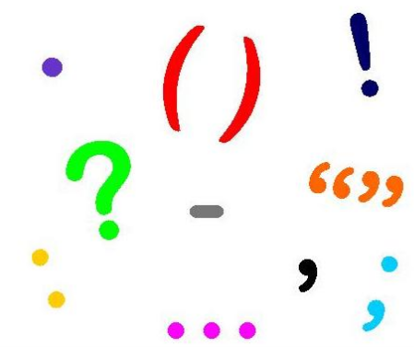
Punctuation removing: EXAMPLE
# Program to all punctuation from the string provided by the user
# define punctuation
punctuations = '''!()-[]{};:'"\,<>./?@#$%^&*_~'''
# take input from the user
my_str = "Hello!!!***, #he said ---and went."
# remove punctuation from the string
no_punct = ""
for char in my_str:
if char not in punctuations:
no_punct = no_punct + char
print(no_punct)

Slide 15
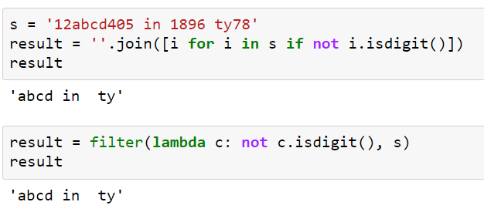
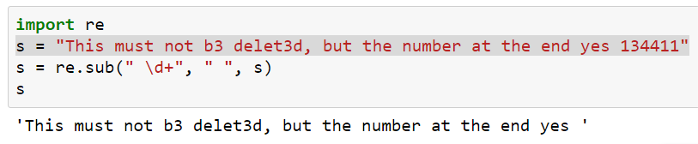
Digits removing
A
L
L
A
L
L
PART
PART

Slide 16
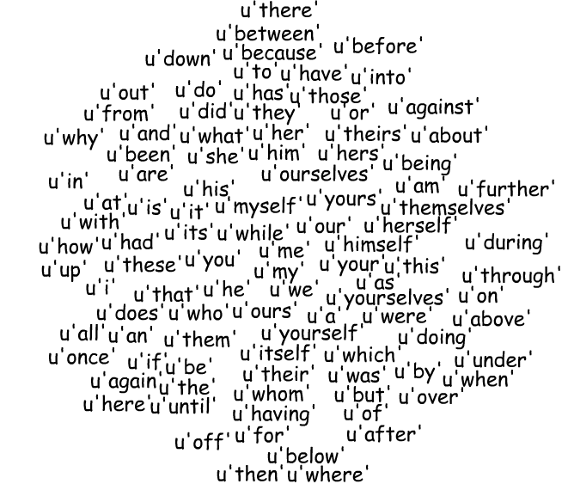
Stopwords removing
Stop words usually refer to the most common words in a language, there is no single universal list of stop words used by all natural language processing tools, and indeed not all tools even use such a list. Some tools specifically avoid removing these stop words to support phrase search.

Slide 17
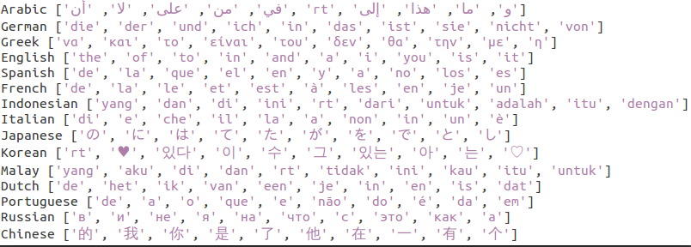
Stopwords removing: Languages

Slide 18
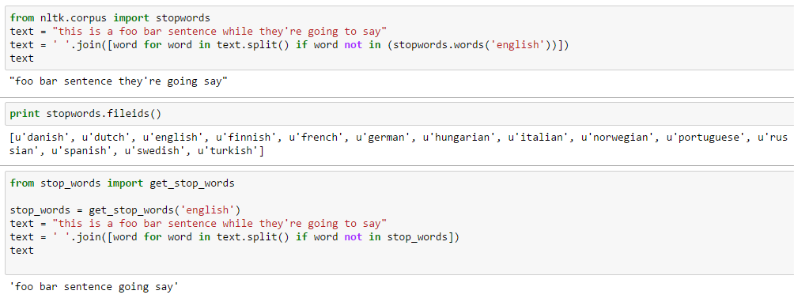
Stopwords removing: Example

Slide 19
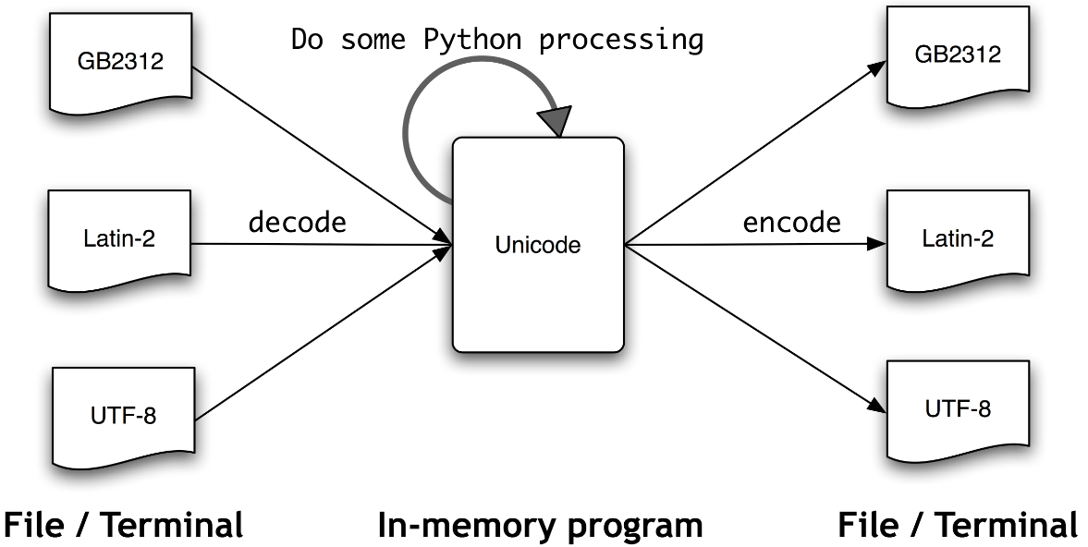
Coding/encoding

Slide 20
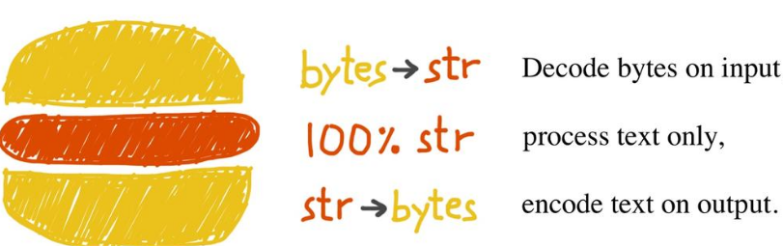
Coding/encoding
The unicode sandwich

Slide 21
Coding/encoding: MAIN POINTS
Strings are one of the most common data types in Python, and sometimes they’ll include non-ASCII characters.
When strings contain non-ASCII characters, they can either be 8-bit strings (encoded strings), or they can be Unicode strings (decoded strings).
To print or display some strings properly, they need to be decoded (Unicode strings).
THE ENCODING/CODEC MAKES ALL THE DIFFERENCE WHEN ENCODING/DECODING STRINGS.

Slide 22
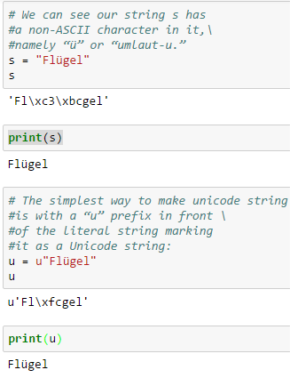
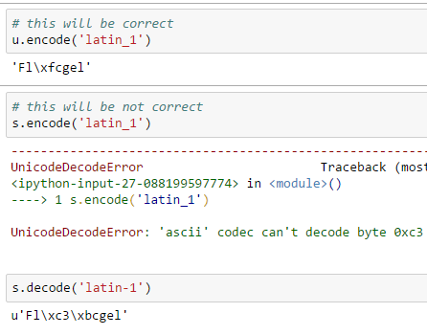
Coding/encoding: EXAMPLES

Slide 23
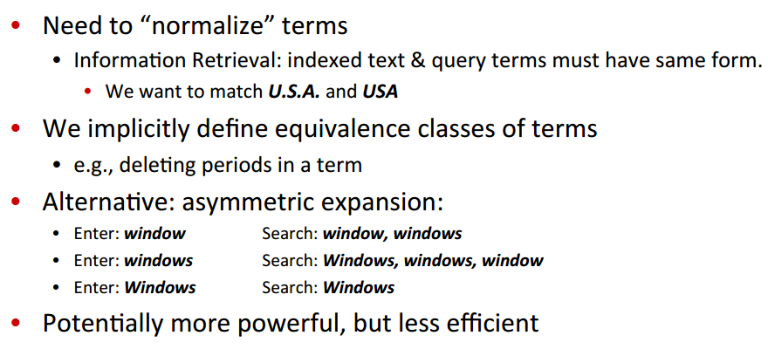
Normalization

Slide 24
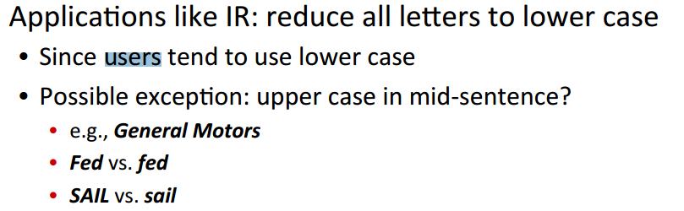
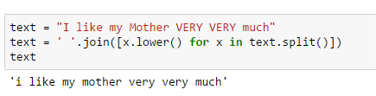
Normalization: Lower Case

Slide 25
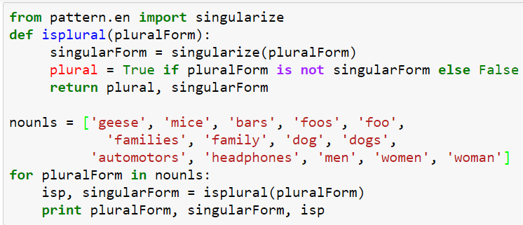
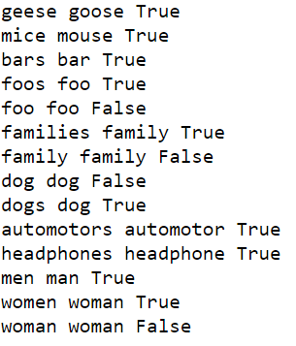
Normalization: Plural to Singular form

Slide 26
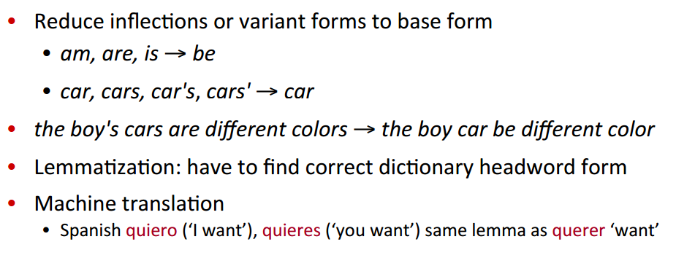
Lemmatization

Slide 27
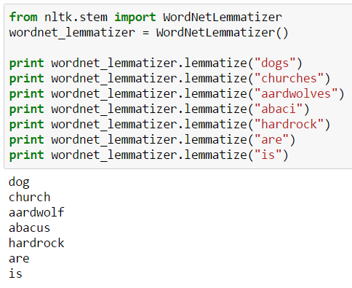
Lemmatization

Slide 28
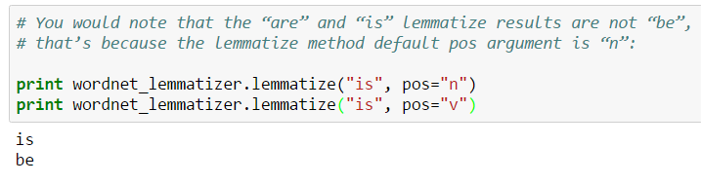
Lemmatization

Slide 29
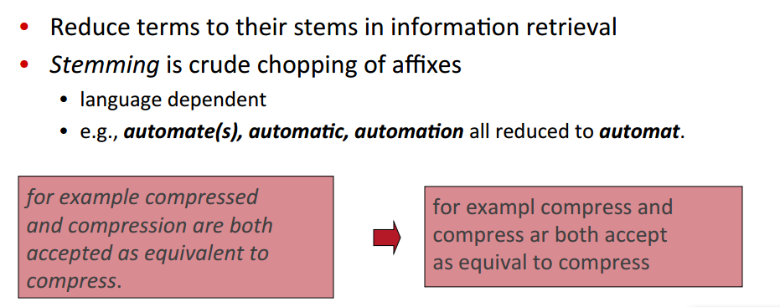
Stemming

Slide 30
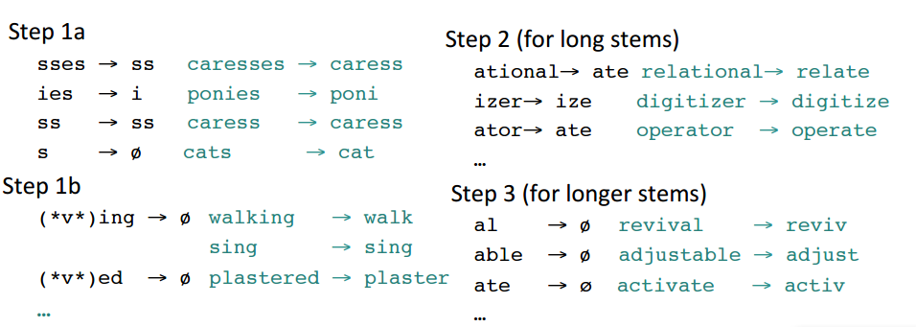
Porter’s algorithm

Slide 31
NLTK Stemmers
Stemming algorithms aim to remove those affixes required for eg. grammatical role, tense, derivational morphology leaving only the stem of the word. This is a difficult problem due to irregular words (eg. common verbs in English), complicated morphological rules, and part-of-speech and sense ambiguities (eg. ``ceil-`` is not the stem of ``ceiling``). StemmerI defines a standard interface for stemmers.
from nltk.stem.api import StemmerI from nltk.stem.regexp import RegexpStemmer from nltk.stem.lancaster import LancasterStemmer from nltk.stem.isri import ISRIStemmer from nltk.stem.porter import PorterStemmer from nltk.stem.snowball import SnowballStemmer from nltk.stem.wordnet import WordNetLemmatizer from nltk.stem.rslp import RSLPStemmer

Slide 32
NLTK Stemmers
Stemming algorithms aim to remove those affixes required for eg. grammatical role, tense, derivational morphology leaving only the stem of the word. This is a difficult problem due to irregular words (eg. common verbs in English), complicated morphological rules, and part-of-speech and sense ambiguities (eg. ``ceil-`` is not the stem of ``ceiling``). StemmerI defines a standard interface for stemmers.
from nltk.stem.api import StemmerI from nltk.stem.regexp import RegexpStemmer from nltk.stem.lancaster import LancasterStemmer from nltk.stem.isri import ISRIStemmer from nltk.stem.porter import PorterStemmer from nltk.stem.snowball import SnowballStemmer from nltk.stem.wordnet import WordNetLemmatizer from nltk.stem.rslp import RSLPStemmer

Slide 33
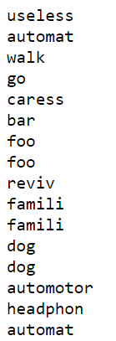
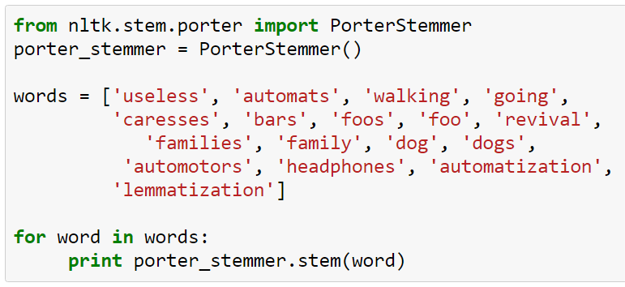
Result:
Porter’s algorithm

Slide 34
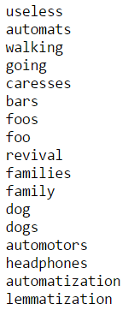
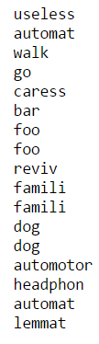

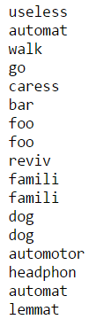
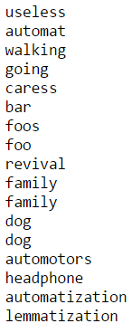
Stemmers
Original
Porter
Lancaster
Snowball
WordNetLemmatizer

Slide 35
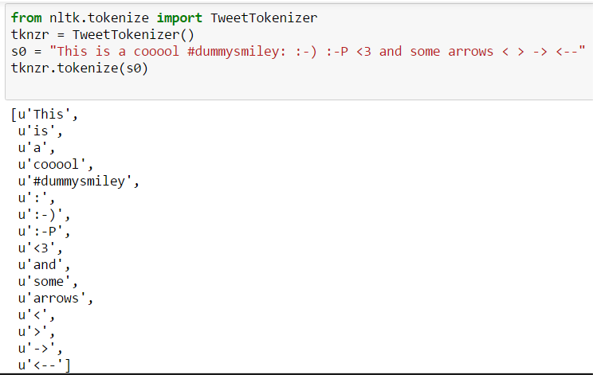

Tokenization: Splitting into words

Slide 36
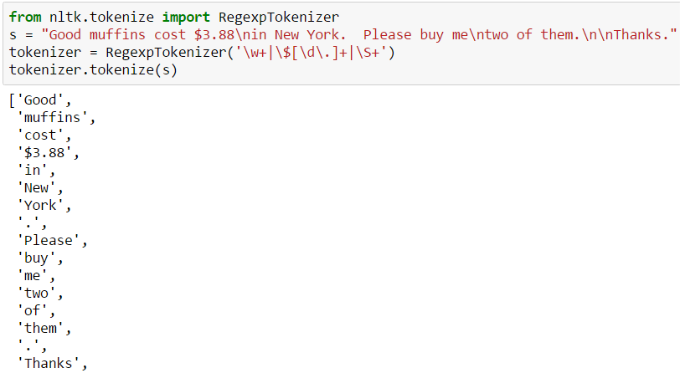

Regular-Expression Tokenizers

Slide 37
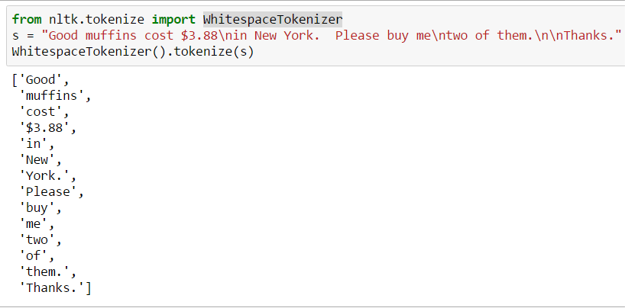

WhitespaceTokenizer

Slide 38
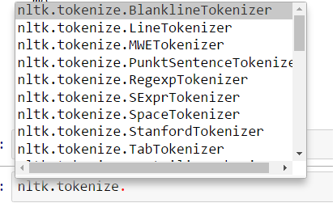
NLTK Tokenizers
http://www.nltk.org/api/nltk.tokenize.html

Slide 39
Thank you!

